Slide 1
CLASS VI
Assignments

Slide 2
1. Prepare a album related to inventions including all subjects.

Slide 3
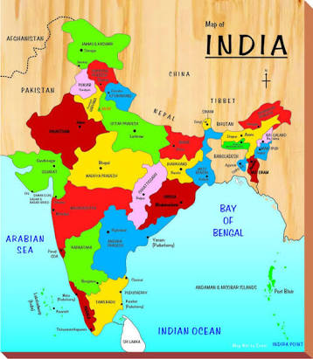
2. Draw an Indian map and make a collage of festivals of India on an Indian map.

Slide 4
3.Choose any human diseases and collect all information for that disease.

Slide 5
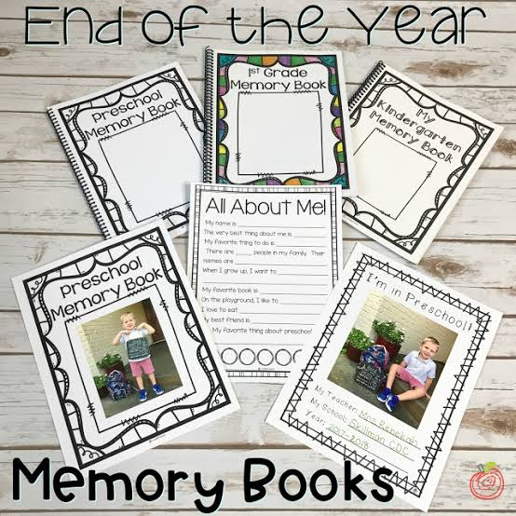
4. Create a memory book of the best moments of the year 2019.it can related with your friends,school and family.

Slide 6
5. Prepare a model from your favourite subjects.students should collect information for the chosen model.

Slide 7
THANK YOU

